Slide 1


Analyzing Medieval Charters through Text Reuse Analysis
Tamás Kovács

Slide 2
Variations of
Text-reuse?
Direct Quotation Directly copying and pasting text from another source
Paraphrase Rephrasing text from another source without significantly altering its meaning or intent.
Allusion Incorporating phrases, ideas, or concepts from another source to enrich or enhance the current text.
Adaptation
Using text from one's own previous work
A practice of incorporating text from one source into another.
Notes:
What is Text Reuse?
Text reuse involves more than just plagiarism; it includes intentional borrowing, adaptation, and even accidental similarities in wording. Recognizing and understanding text reuse is important for researchers, writers, and anyone dealing with information, ensuring proper attribution and originality.
Paraphrase: To express someone else's idea using your own words, typically referring to a particular text or concept.
Allusion: To make an indirect reference to another work or historical event, which very frequently depth to the current text. Classical Philologist

Slide 3
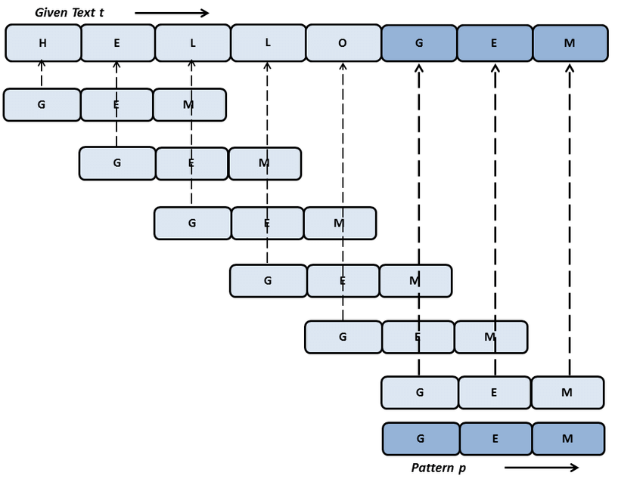
Methods:
String Matching
How it Works:
Directly compares character sequences (strings) between documents.
Exact matches or near-exact matches (allowing for minor differences).
Strengths:
Simple to understand and implement.
Good for detecting verbatim copying.
Weaknesses:
Doesn't handle paraphrasing well.
Not suitable for identifying conceptual similarities.
Verbatim copying (exact matches or minor variations)
Notes:
How it Works:
Directly compares character sequences (strings) between documents.
Exact matches or near-exact matches (allowing for minor differences).
Strengths:
Simple to understand and implement.
Good for detecting verbatim copying.
Weaknesses:
Doesn't handle paraphrasing well.
Not suitable for identifying conceptual similarities.

Slide 4
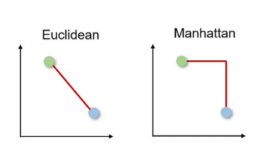
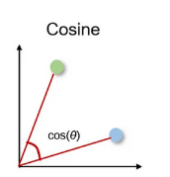
Methods:
Distance Metrics
How it Works:
Quantifies the difference between documents using numerical distances.
Examples: Euclidean distance, Manhattan distance.
Strengths:
Captures the overall "distance" between texts.
Can be applied to various types of data.
Weaknesses:
Sensitive to the representation of the text (e.g., word counts).
May not reveal the nature of the similarity.
Overall similarity, potential paraphrasing, similar themes/topics
Notes:
the Euclidean distance measures the shortest straight-line distance between two points, while the Manhattan distance measures the distance by summing the absolute differences along each dimension, akin to navigating a grid-like path in a city. The Manhattan distance between two points is the total distance you would travel if you could only move along the grid lines

Slide 5
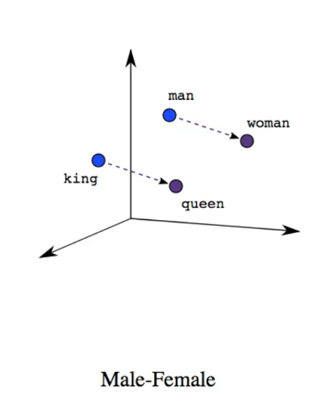
Methods:
Word Embeddings
How it Works:
Represents words as vectors in a high-dimensional space.
Words with similar meanings are closer together in this space.
Strengths:
Captures semantic relationships between words (King - Queen).
Can be used for paraphrasing detection and similarity analysis.
Weaknesses:
Requires training on large datasets.
May not work well with out-of-vocabulary words.
Word2Vec, FastText: Paraphrasing, texts with similar concepts (even if words differ)

Slide 6
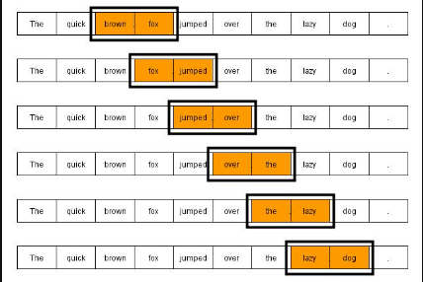
Methods:
N-Grams
How it Works:
Breaks text into overlapping sequences of N words (or characters).
Compares the frequency of n-grams between documents.
Strengths:
Simple and versatile approach.
Can detect various forms of text reuse, including plagiarism.
Weaknesses:
Sensitive to the choice of N.
May miss long-range dependencies.
Verbatim copying, paraphrasing, reuse of phrases/sentence structures
Notes:
Even when synonyms are used to paraphrase, many n-grams may still overlap, especially for less frequently substituted parts of the text
N-grams can detect similar syntactic structures, even if some words are replaced.

Slide 7
Methods:
Minihash
How it Works:
Uses hash functions to create signatures (fingerprints) for documents.
Compares the signatures to estimate the similarity between documents.
Strengths:
Efficient for large-scale similarity comparisons.
Suitable for near-duplicate detection.
Weaknesses:
Does not capture semantic meaning.
May not work well with short documents.
Notes:
Imagine you have a big box of toys,and you want to organize them.
You could put all the cars in one corner, the dolls in another, and the building blocks in a third.
Hashing is a similar. A hash is like a special code that represents a piece of data, like a word, a number, or even a whole file.
Instead of putting toys in different corners, a hash function takes your data and assigns it a unique code.
This code is usually a string of letters and numbers, and it's always the same length, no matter how big or small the original data was.Think of it like a name tag for your data.
Even if you have two very different pieces of data, they can have completely different hash codes.

Slide 8
Comparison
Metric | Description | Use Cases | Speed (Relative) | Approximate Time (2x5000 pages)
String Matching | Exact comparison of text strings | Plagiarism detection, Duplicate content identification | Slow | Hours to Days
Distance Metrics (Euclidean) | Measures "distance" between vectorized text representations | Text similarity assessment, Document clustering | Medium | Minutes to Hours
Word Embeddings | Uses dense vector representations of words to compare texts | Semantic similarity analysis, Text classification, Information retrieval | Medium to Slow | Minutes to Hours
N-grams | Compares texts based on sequences of n words | Language modeling, Text generation, Authorship attribution | Fast | Seconds to Minutes
Hash (MinHash) | Uses hash functions to estimate text similarity | Near-duplicate detection, Large-scale document comparison | Very Fast | Seconds
Notes:
String Matching: This method is not ideal for detecting similarity with spelling mistakes, as it requires exact matches. It would miss similarities in texts with typos or minor variations.
Distance Metrics (like Euclidean distance): These can be more forgiving of spelling mistakes, especially when used with character-level representations. However, they might still struggle with more significant variations or word order changes.
Word Embeddings: These are generally good at capturing semantic similarity, but standard implementations might struggle with misspelled words as they typically work with predefined vocabularies. However, some advanced techniques like fastText can handle out-of-vocabulary words and misspellings better.
N-grams: Character-level n-grams can be quite effective for detecting similarity despite spelling mistakes. They break the text into small chunks, so minor spelling errors don't significantly impact the overall similarity score.
Hash (MinHash): While fast, basic hash functions are sensitive to spelling changes. However, locality-sensitive hashing techniques can be designed to be more robust to minor variations.
Considering all factors, a combination of character-level n-grams and more advanced word embedding techniques (like fastText) would likely be most effective for similarity detection that's robust to spelling mistakes.
N-grams can capture character-level patterns, making them resilient to minor spelling errors. They're also relatively fast to compute. Advanced word embeddings can capture semantic similarity even when words are misspelled, as long as they're reasonably close to correct spellings.
For large-scale applications where speed is crucial, a two-stage approach might be beneficial: use a fast method like locality-sensitive hashing for initial filtering, then apply more sophisticated techniques like n-grams or word embeddings on the reduced set of potentially similar documents.
Combining MinHash with overlapping n-grams is indeed a powerful approach for similarity detection that can handle spelling mistakes and other variations. Let me elaborate on why this combination is particularly effective:
N-grams for robustness:
By using overlapping n-grams (especially character-level n-grams), we break the text into small, overlapping chunks.
This approach is inherently tolerant to spelling mistakes and small variations, as many n-grams will still match even if there are some errors.
MinHash for efficiency:
MinHash is a locality-sensitive hashing technique that can quickly estimate the similarity between large sets.
It dramatically reduces the computational complexity of comparing documents, making it feasible to perform similarity detection on large datasets.
Combining the two:
By applying MinHash to the set of overlapping n-grams, we get the best of both worlds: the spelling-mistake tolerance of n-grams and the computational efficiency of MinHash.
This method can quickly identify potentially similar documents even when they contain spelling errors or small variations.

Slide 9
WHY?

Slide 10
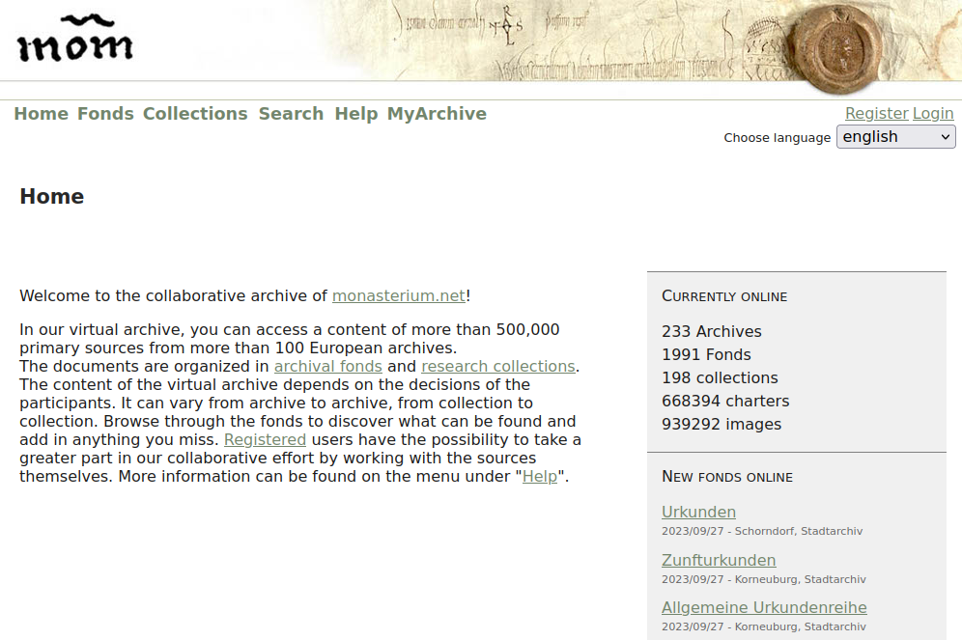
The Project and its data
ERC DiDip (From Digital to Distant Diplomatics)
2022-2026
New Virtual Research Environment (VRE)
Monasterium.net
600 000 European charters
Wide geographical distribution (geographical distribution)
Various Medieval Languages, including dialect variations
The Monasterium.net platform is the largest publicly available collection of digitized
medieval charters.

Slide 11
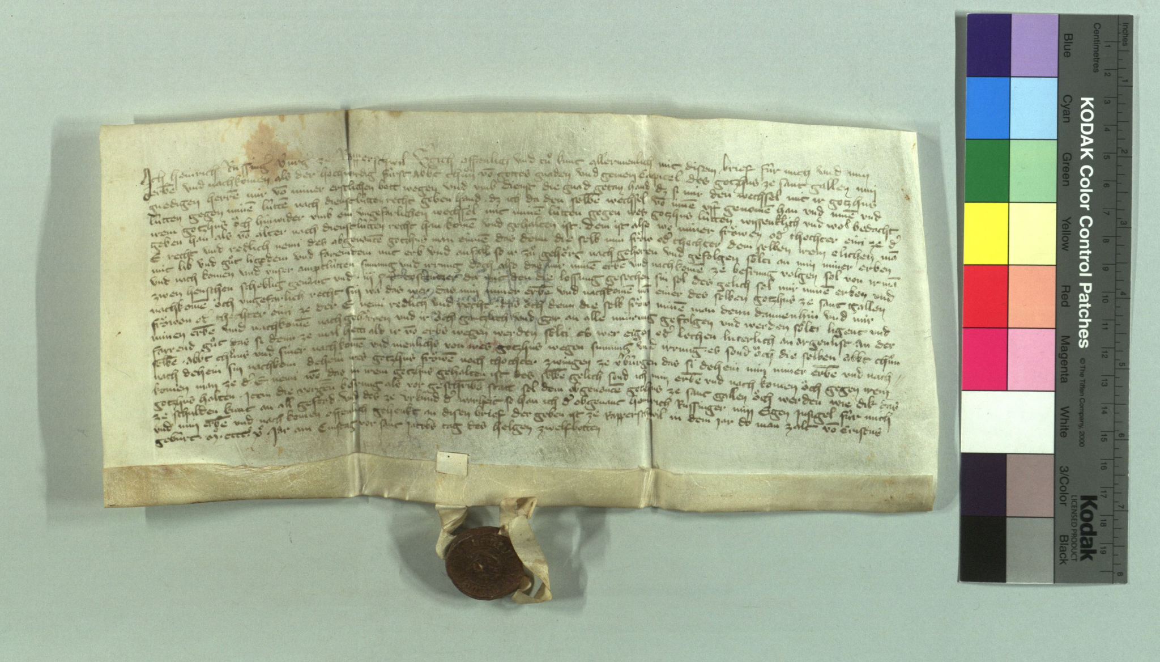
The Charter
Parts of a Medieval charter
Invocation
Shows religious or regional influences through variations in its divine authority invocation.
Arenga
Ripe for text reuse analysis; utilizes sources from biblical, legal, or patristic traditions to justify the charter's issuance.
Notification
Ensures public recognition and future enforcement, useful for social network analysis.
Dispositive Section
Details legal rights and obligations, crucial for understanding medieval property rights and governance.
Sanction
Details legal rights and obligations, crucial for understanding medieval property rights and governance.
Date and Eschatocol Important for historical context; signatures reveal social and political networks.
is formulaic, with certain phrases and structures repeated across different documents and regions
Chartularium Sangallense 13 (1405-1411) 7956 (monasterium.net)

Slide 12
What are
Arengas?
Purpose - Introductory statements in charters, providing moral or legal justifications, connecting mundane legal transactions to broader divine and societal laws.
Content and Themes - Often uses rhetorical and legal phrases
- Variability reflects the charter's purpose, e.g., emphasizing benevolence or justice based on the grantor's intent.
Significance - Embeds the charter's actions within accepted moral and social values, enhancing authority and significance.
- Mirrors the ethical, moral, and legal philosophies of the time, indicating societal norms and values.
… integral components of charters, serve a profound purpose beyond their presence as mere preambles.
Notes:
Arengas are pivotal for understanding the nexus between law and society in medieval times, demonstrating the profound impact of textual practices on medieval societal structures.
They are crafted not only to contextualize and justify the contents of the charter but also to reflect the prevailing ethical, moral, and legal philosophies of the era.
The formulation of arengas typically involves drawing upon a repertoire of established, often reused rhetorical and legal phrases. This reuse a strategy to evoke the weight of tradition and legal precedent. Examples of arengas vary widely, reflecting the document's purpose and the drafter's intent.
For example, a charter granting land might include an arenga emphasizing the benevolence and piety of the grantor. These rhetorical strategies are particularly fascinating when studied through the lens of text reuse. Similarity detection or thematic analysis, can identify commonalities in the phrasing of arengas across various charters.
Such analysis reveals not only patterns of textual borrowing and adaptation but also shifts in political, religious, and social attitudes over space and time.

Slide 13

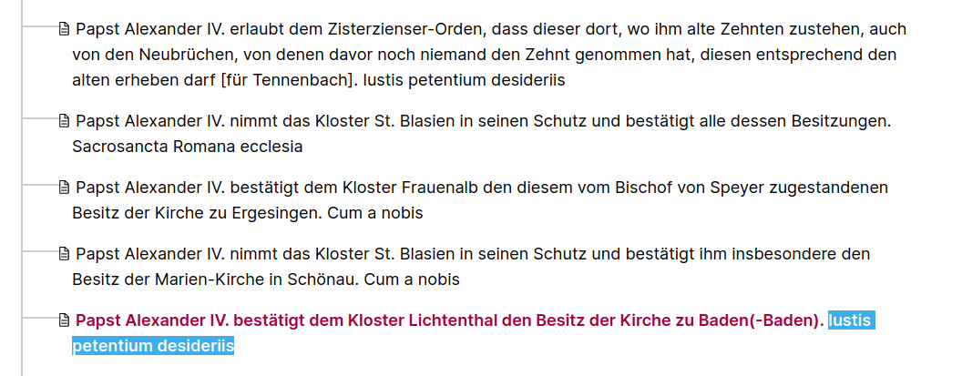
Iustis petentium desideriis
(the desires of those who ask justly)
… a widespread formula all over Europe (12-13 c.), well known from papal charters of Pope Gregory IX, Pope Innocent III and Pope Honorius III
1256 Oktober 31, Lichtental. Landesarchiv Baden-Württemberg, Abt. Generallandesarchiv Karlsruhe, E Nr. 224
Secondary source: Juhász Csaba: A felszabadító oklevelek arengái In Micae Mediaevales iv. 2015: Budapest. 97-105.
Notes:
The development of the iustis petentium desideriis formula, well known from papal charters of Pope Gregory, Pope Innocentus iii and Pope Honorius iii, the same form is repeatedly used in the same form.
The formula was widespread and known throughout Europe.

Slide 14
Iustis petentium desideriis
1186-00-00, Pannonhalma (National Archive of Hungary Diplomatic Photocollection 208, Nr. 291)
Iustis petentium desideriis facilem nos decet adhibere consensum, et vota, quibus aequitatis libra consentit, efficaci sunt prosecutione complenda
1294-00-00, Weszprimensis (Codex Diplomaticus (Fejér) VI/1, Nr. 38)
Iustis petentium desideriis dignum est nos facilem praebere consensum, et vota, quae a rationis tramite non discordant, effectu prosequente complere
Secondary source: Juhász Csaba: A felszabadító oklevelek arengái In Micae Mediaevales iv. 2015: Budapest. 97-105.
Notes:
The sentences contain shared terms and phrases, the "Iustis petentium desideriis" appears in the first two sentences and translates to "the just desires of the petitioners". This repetition emphasizes the theme of justice and fairness in considering the desires or requests of others.
The "aequitatis libra” appears in both the first sentence and the third, signifying "the balance of equity". It's a metaphorical representation of fairness and justice, suggesting that decisions should be balanced and fair.

Slide 15
Iustis petentium desideriis
6th century, Ravenna. Cassiodori Senatoris Variae. MGH Auct. ant. 12
Sic enim aequitatis libra servabitur, si auxilium largiamur imparibus et metum nostri pro parvulis insolentibus opponamus
1085, Manegoldus, Liber ad Gebehardum (Karlsruhe, Badische Landesbibliothek, Cod. Rastatt 27)
Omnes debet gubernare, maiore gratia virtutum super ceteros debeat splendere, traditam sibi potestatem summo equitatis libramine studeat administrare
Secondary source: Juhász Csaba: A felszabadító oklevelek arengái In Micae Mediaevales iv. 2015: Budapest. 97-105.
Notes:
But it is based on a familiar topos: the balance of justice which was an attribute of the goddess iustitia.
The first occurrence of it is in Cassiodorus Variarum 1,8,1 and in a late work in Manegold's Liber ad Gebehardum. The context is the same in all cases. the king's virtue as a ruler is best exercised, according to the scales of justice, when he supports the poor against the wealthy and powerful.
The widespread spread of the topos can be traced mainly in papal, imperial and later royal charters, and we even find a specific version of it in one of the papal evolutions of Orban III.

Slide 16
HOW?
D04/D4TR_STYLO_S3_Text_reuse_analytics_with_minihash.ipynb

Slide 17
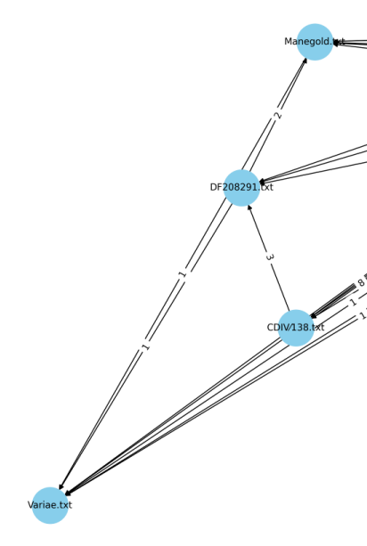
Results
1186-00-00, Pannonhalma (National Archive of Hungary Diplomatic Photocollection 208, Nr. 291)
Iustis petentium desideriis facilem nos decet adhibere consensum, et vota, quibus aequitatis libra consentit, efficaci sunt prosecutione complenda
1294-00-00, Weszprimensis (Codex Diplomaticus (Fejér) VI/1, Nr. 38)
Iustis petentium desideriis dignum est nos facilem praebere consensum, et vota, quae a rationis tramite non discordant, effectu prosequente complere
6th century, Ravenna. Cassiodori Senatoris Variae. MGH Auct. ant. 12
Sic enim aequitatis libra servabitur, si auxilium largiamur imparibus et metum nostri pro parvulis insolentibus opponamus
1085, Manegoldus, Liber ad Gebehardum (Karlsruhe, Badische Landesbibliothek, Cod. Rastatt 27)
Omnes debet gubernare, maiore gratia virtutum super ceteros debeat splendere, traditam sibi potestatem summo equitatis libramine studeat administrare
Iustis petentium desideriis
"similarity": 0.9189261198043823,
"text1_filename": "DF208291.txt",
"text1_text": "et vota quibus aequitatis libra",
"text1_window_start": 8,
"text2_filename": "Variae.txt",
"text2_text": "Sic enim aequitatis libra servabitur,",
"text2_window_start": 0

Slide 18
Thank you!
Questions? Remarks?

